Slide 1

2019 Data Challenge
Jeremiah Radabuagh, David Burke, and Kevin Lewis

Slide 2
summary.
“Is there a way to tell what communication method (call, texting or email) is more successful with clients, either based on their success in job placement or some other outcome?”

Slide 3

problem and motivation.
Communication is key
76% wish for speedy communication
Most effective forms of communication
Efficient communication = more responses
More responses = loyal customers
Loyal customers = more money

Slide 4
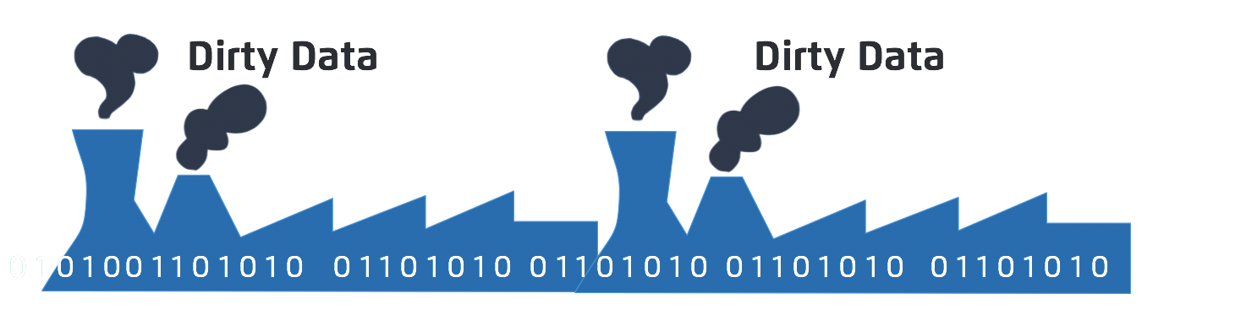
approach.
Very dirty data
Nested IF functions with AND-OR’s
Created business rules
Able to determine responses and response types

Slide 5

datasets.
SalesForce_2018Activities
All information on hand
Purpose was missing
Hire Hero’s response

Slide 6

tools and analytics.
Excel formulas for cleaning
Knime
CSV Reader
Decision Tree

Slide 7
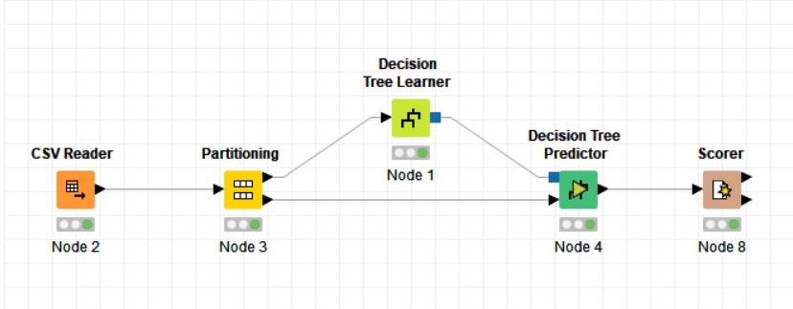
knime matrix.

Slide 8

results.
The results were clear
Data cleaning was thorough
Showed text messages at the top
Text and email are clearly the most effective
New generation = new forms of communication

Slide 9
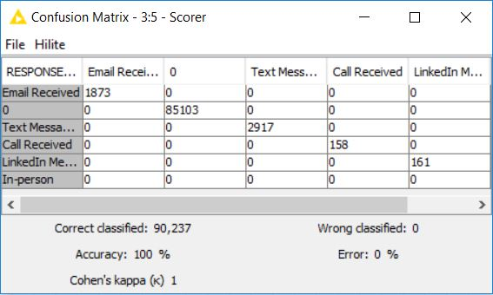
knime solution.

Slide 10

questions?
thank you!

